Slide 1









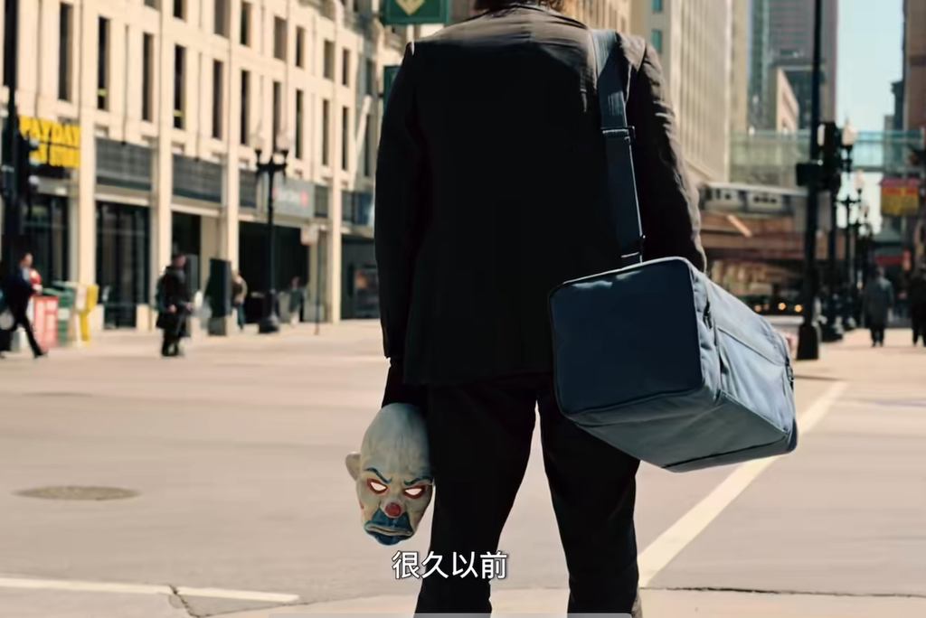
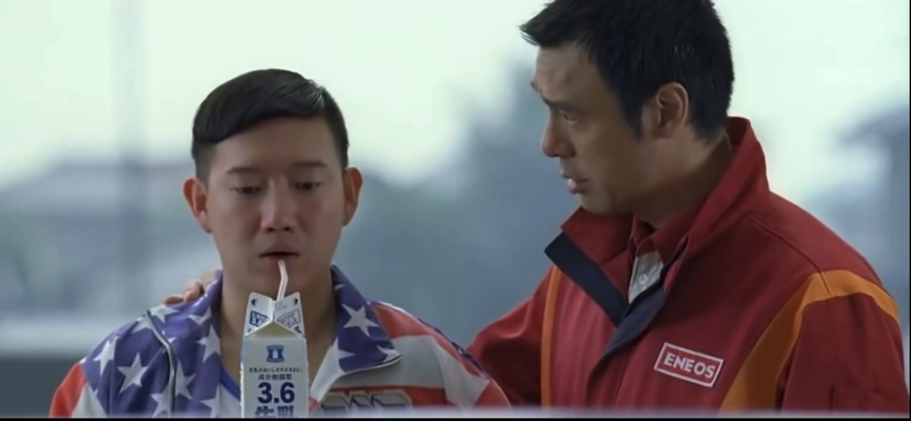
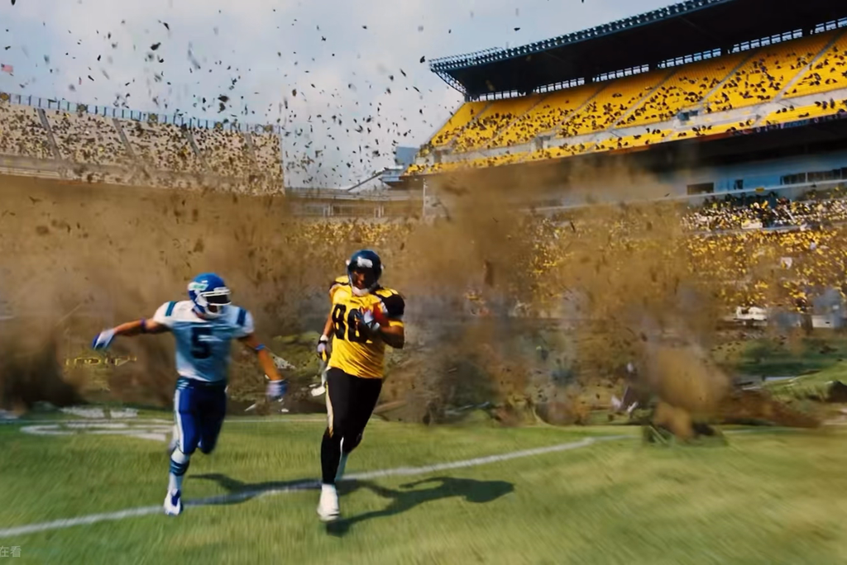
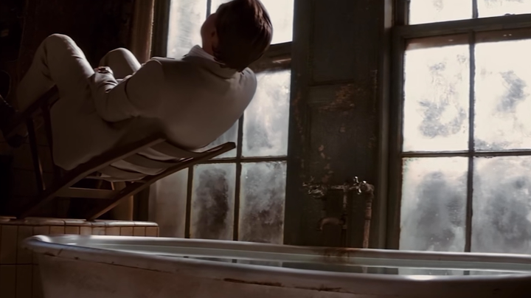
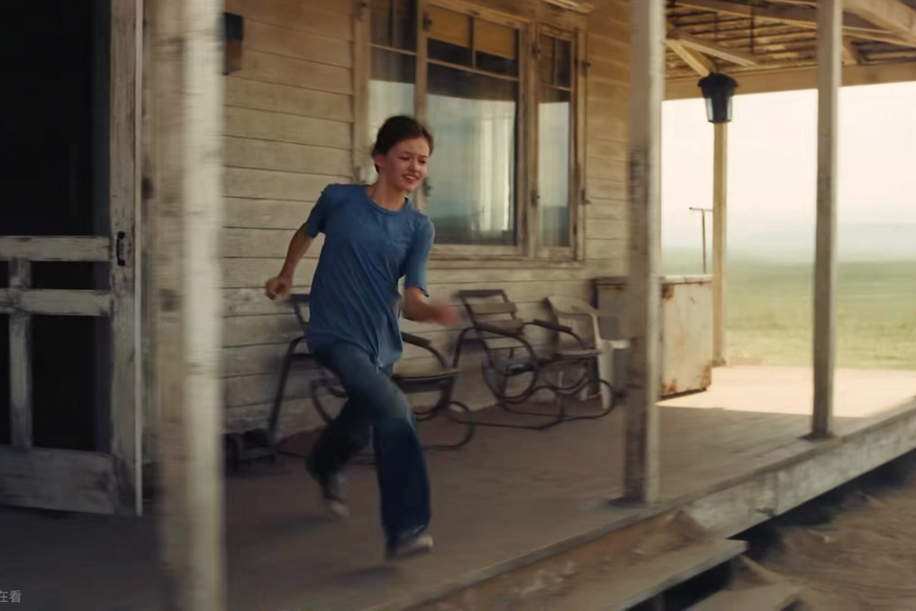
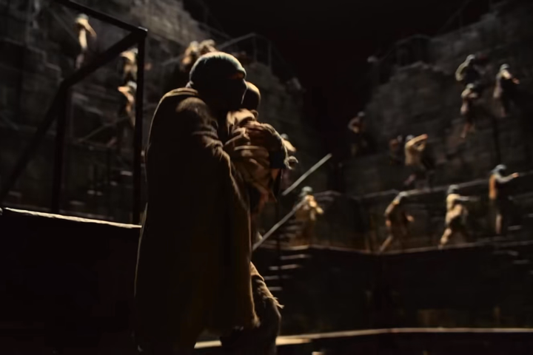
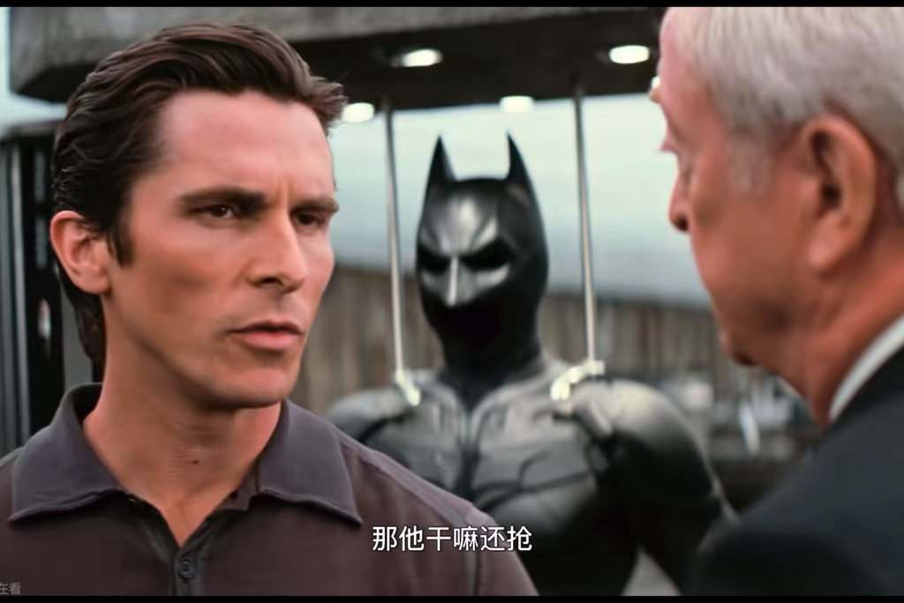
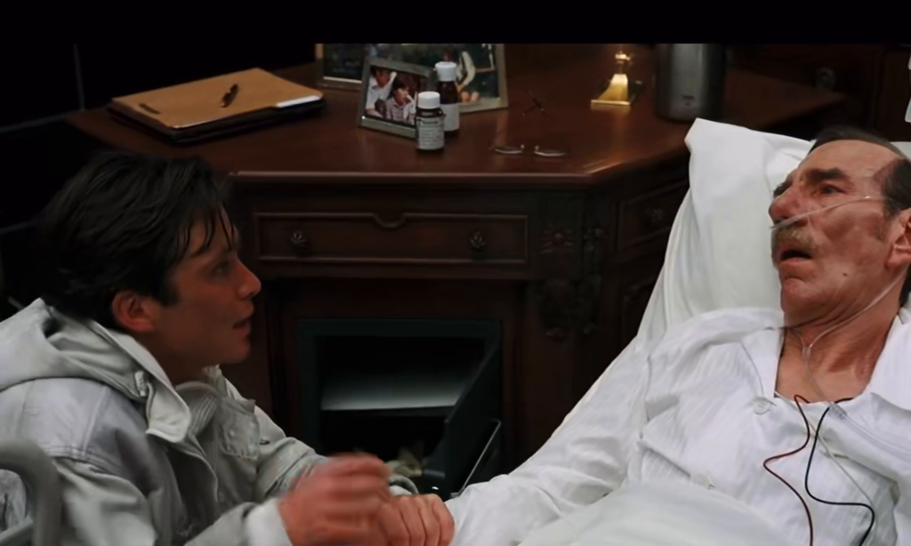





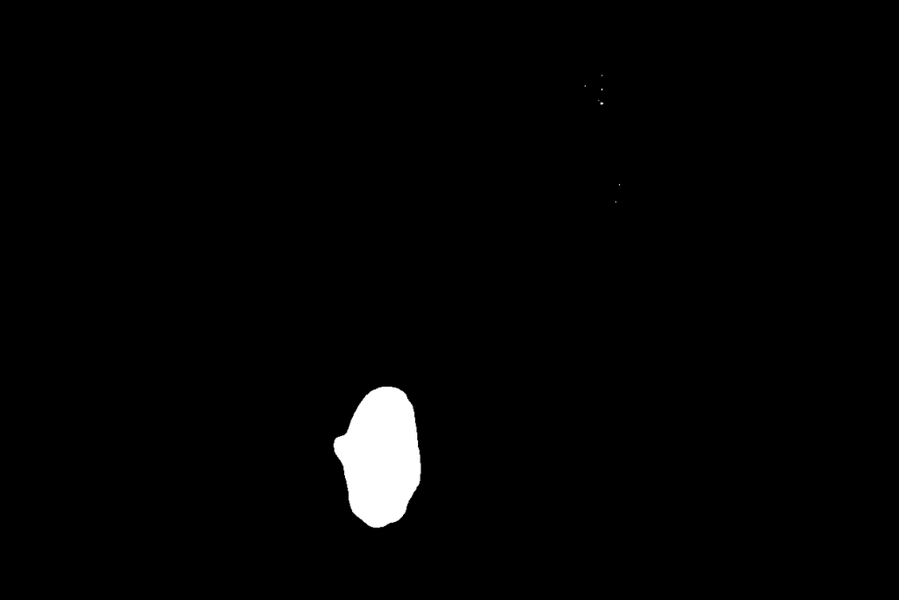







Num
++
Motion State
YES | NO
Motion Intensity
++
FB Confusion
YES | NO
Semantic Understanding
YES | NO
the joker mask held in hand
the white milk caton and straw
the player with yellow clothes
the man sitting on chair fell off
the girl running out of the house
people running in background
the man who looks orderly
the man who is weak and sick

Slide 2
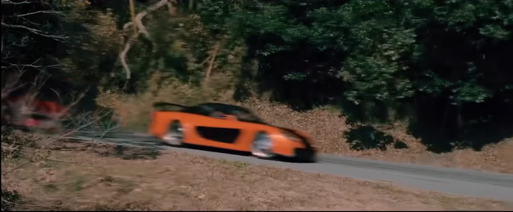
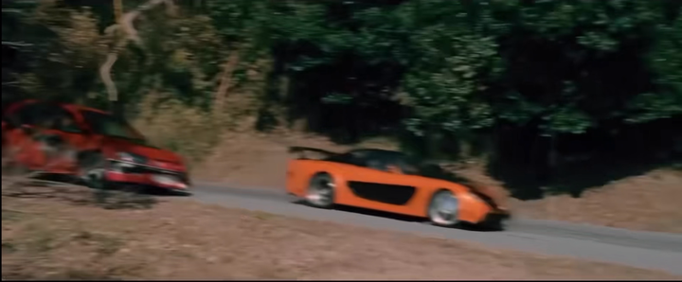
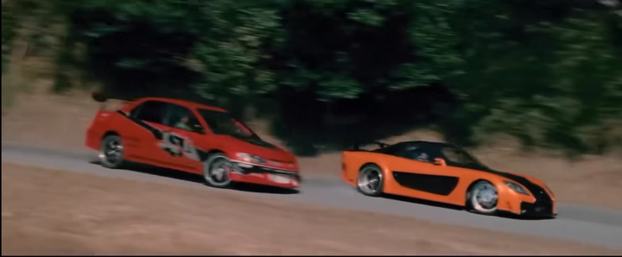
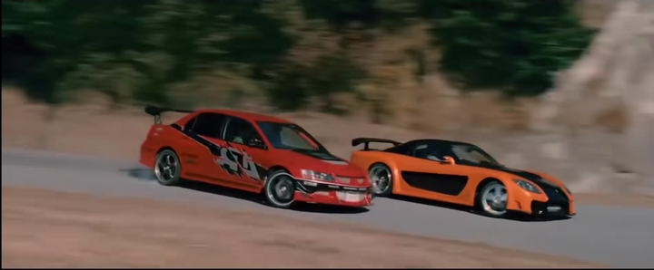
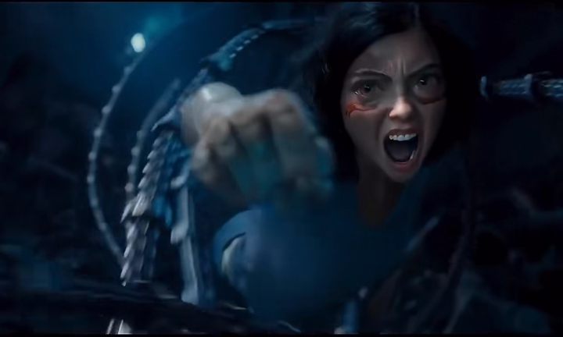
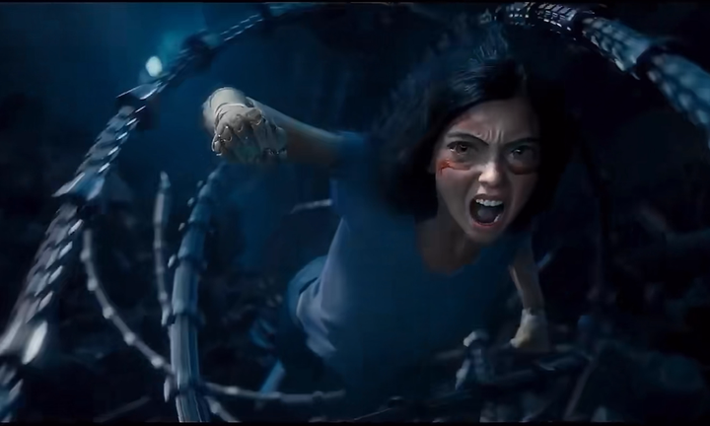
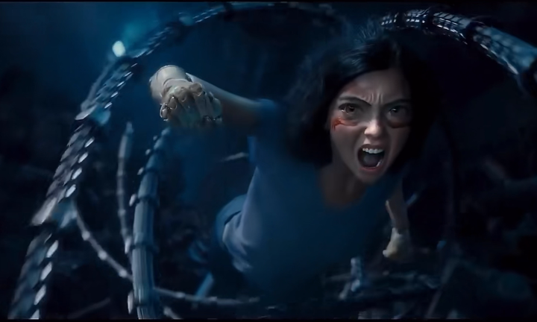
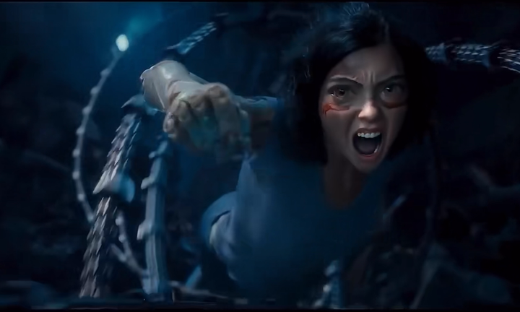








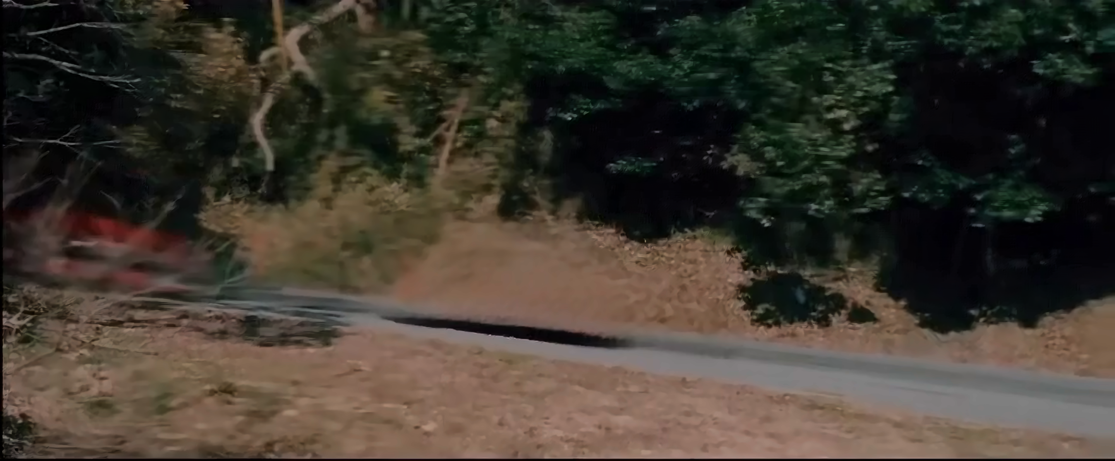
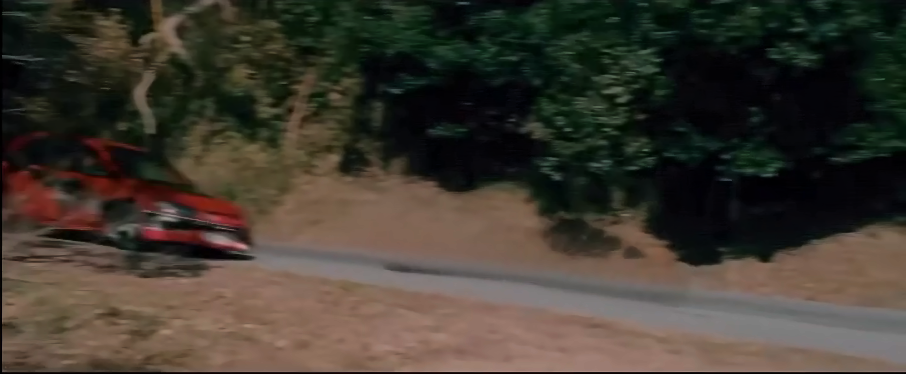
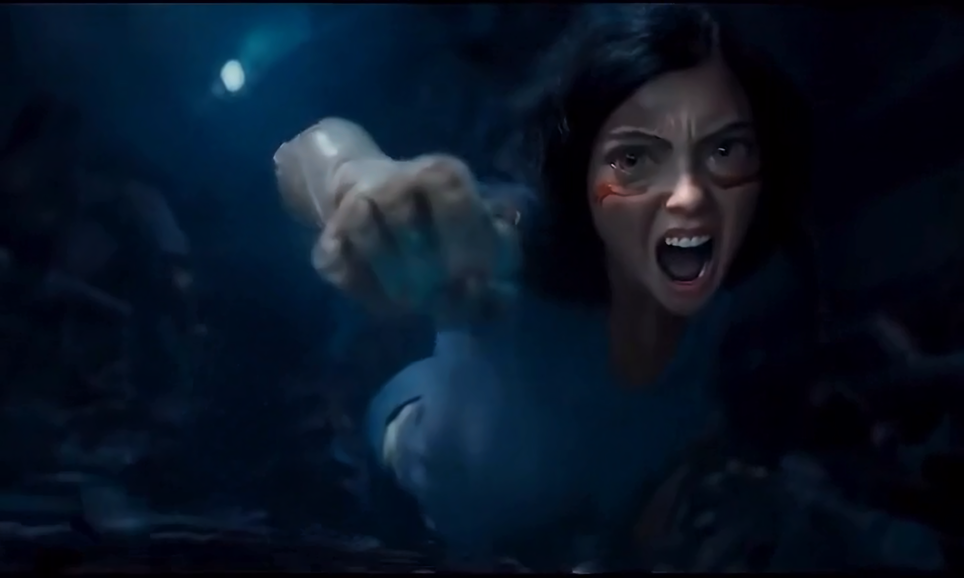
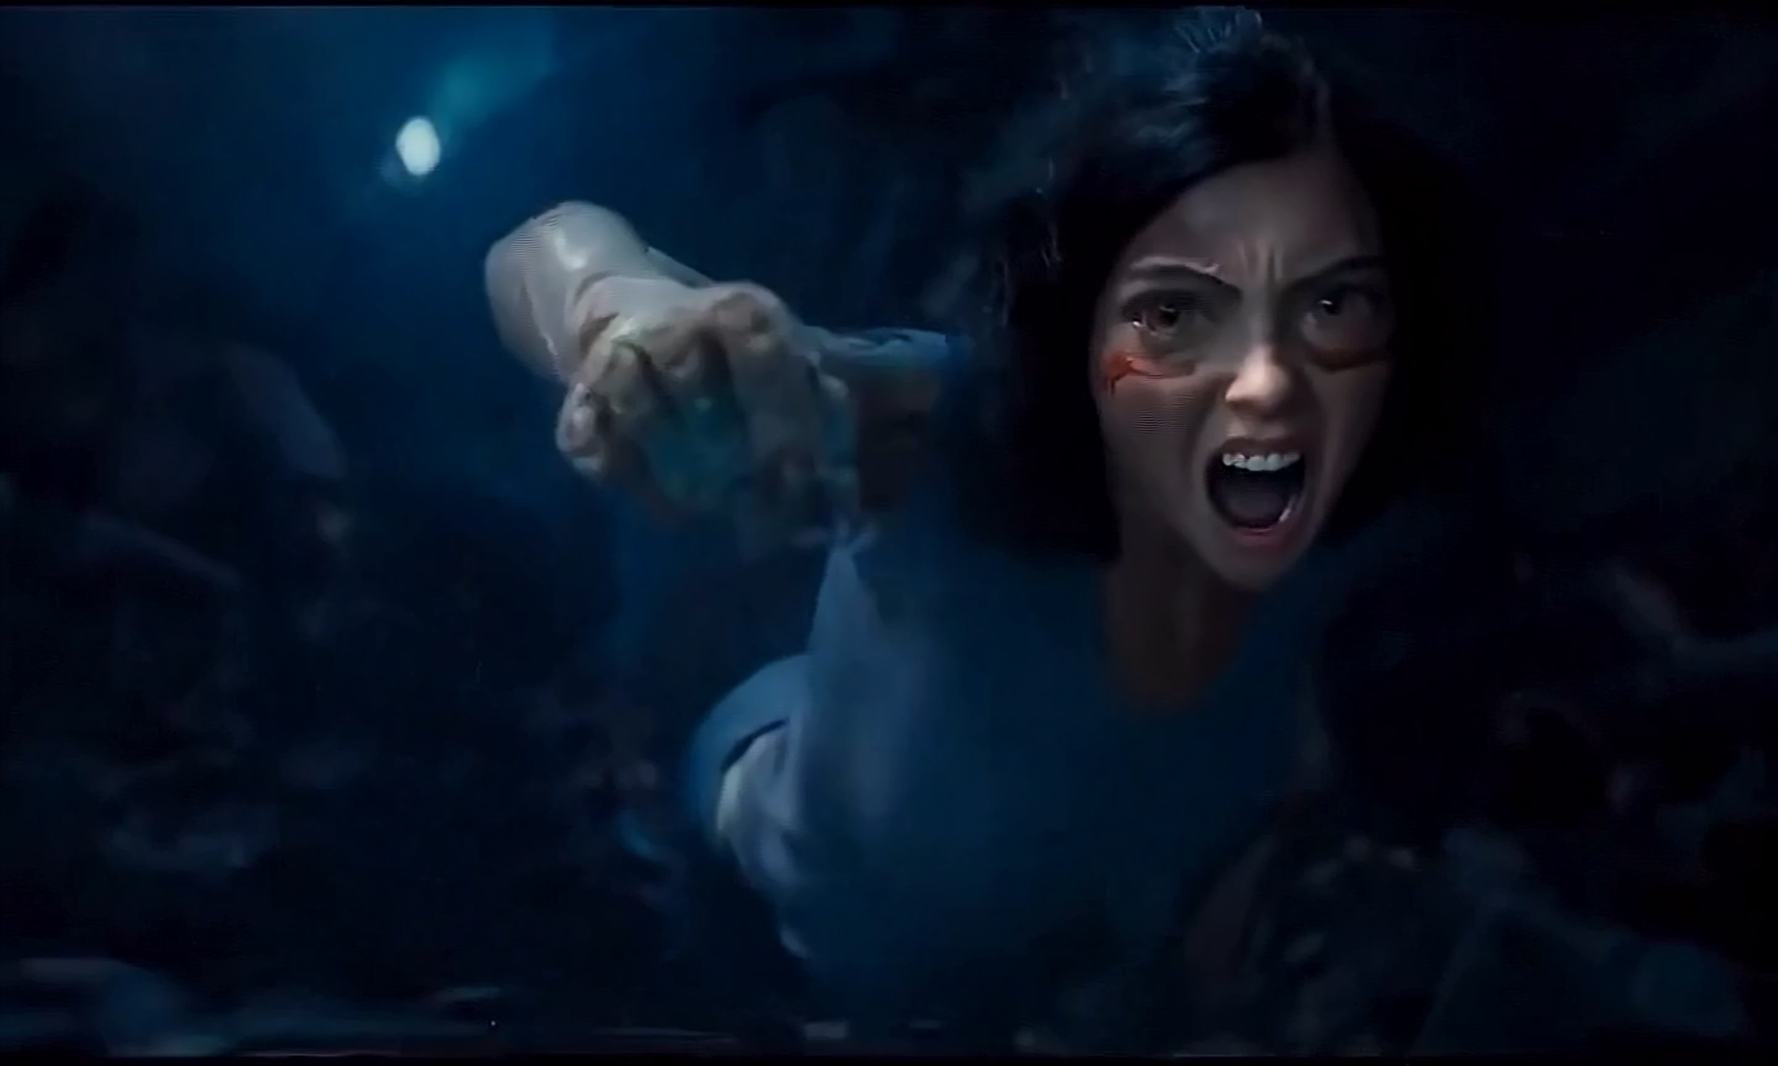
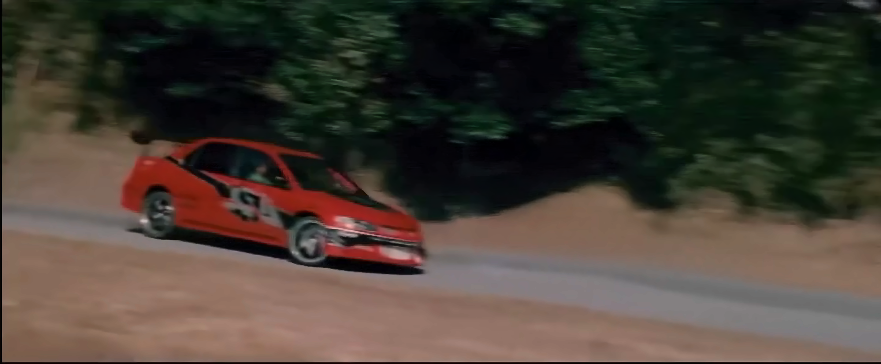
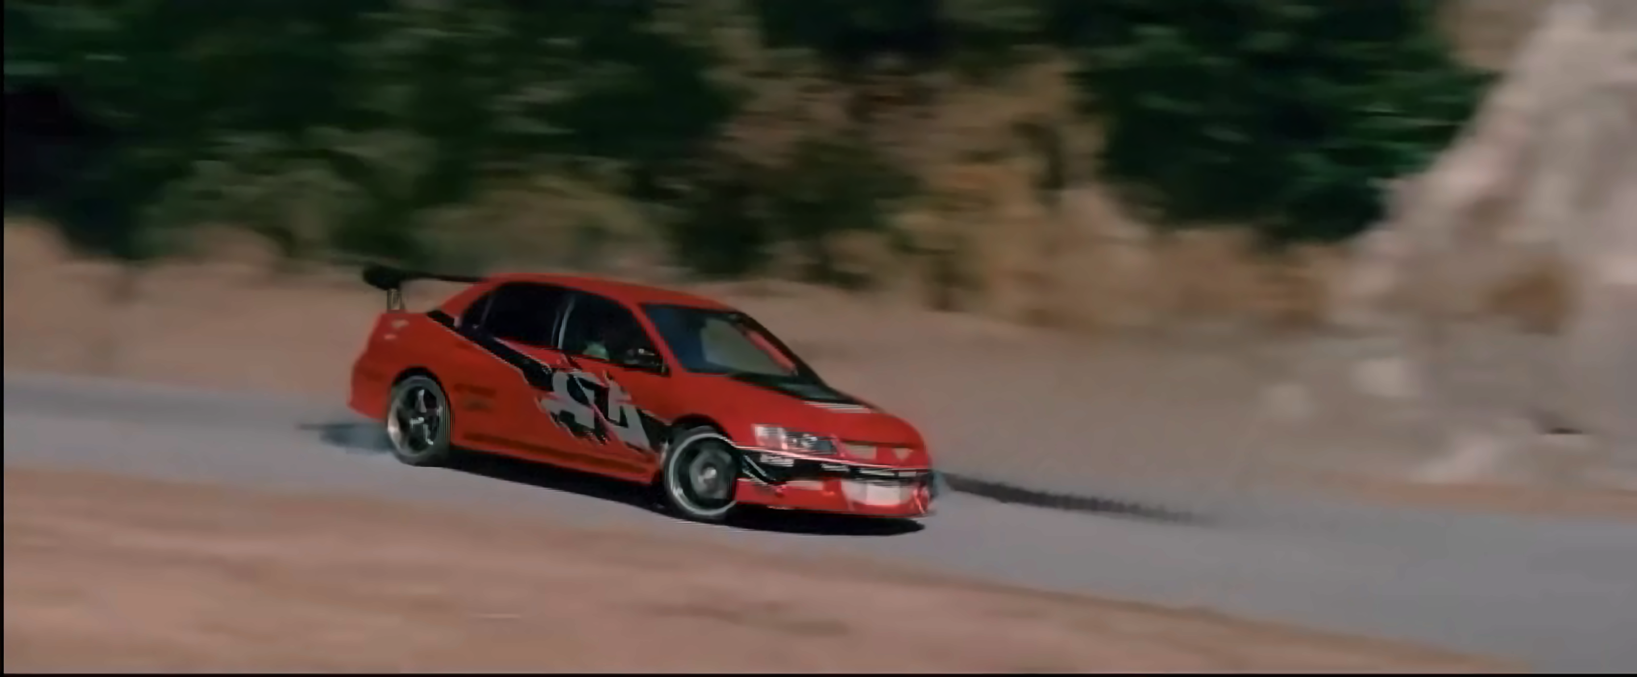
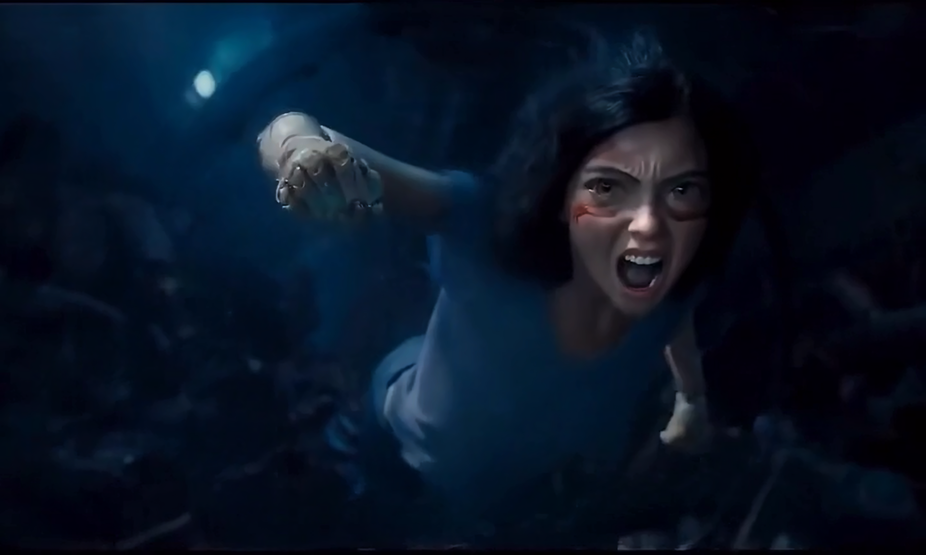


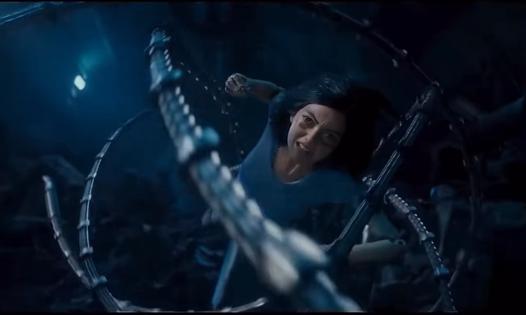
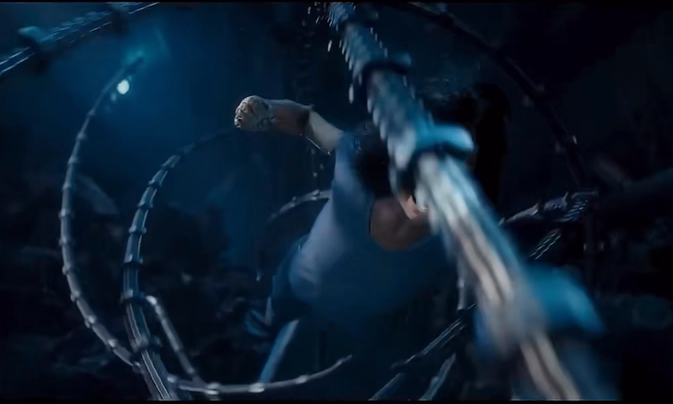
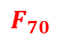
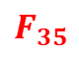
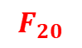
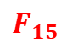
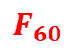
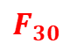
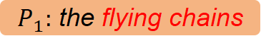
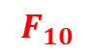
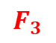
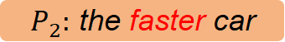
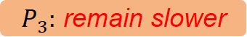
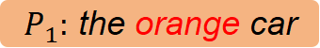
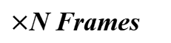
Continuous Rapid Movement in Tokyo Drift Video
Continuous Rapid Movement in Alita Battle Angel
$$F_{3}$$
$$F_{10}$$
$$F_{30}$$
$$F_{60}$$
$$F_{15}$$
$$F_{20}$$
$$F_{35}$$
$$F_{70}$$
$P_{1}:$ the orange car
$P_{1}:$ the flying chains
Semantic Understanding: I know they are the same!
Motion State & Intensity: Continuous + Dense Video Inpaint
$×$N Frames
$P_{2}:$ the faster car
$P_{3}:$ remain slower
......

Slide 3

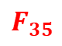
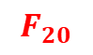
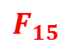
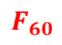
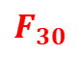
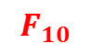
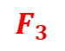
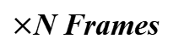
Continuous Rapid Movement in Tokyo Drift Video
Continuous Rapid Movement in Alita Battle Angel
$$F_{3}$$
$$F_{10}$$
$$F_{30}$$
$$F_{60}$$
$$F_{15}$$
$$F_{20}$$
$$F_{35}$$
$$F_{70}$$
$P_{1}:$ the orange car
$P_{1}:$ the flying chains
Semantic Understanding: I know they are the same!
Motion State & Intensity: Continuous + Dense Video Inpaint
$×$N Frames
$P_{2}:$ the faster car
$P_{3}:$ remain slower
......

Slide 4
Num
++
Motion State
YES | NO
Motion Intensity
++
FB Confusion
YES | NO
Semantic Understanding
YES | NO
the joker mask held in hand
the white milk caton and straw
the player with yellow clothes
the man sitting on chair fell off
the girl running out of the house
people running in background
the man who looks orderly
the man who is weak and sick
Continuous Rapid Movement in Tokyo Drift Video
Continuous Rapid Movement in Alita Battle Angel
$$F_{3}$$
$$F_{10}$$
$$F_{30}$$
$$F_{60}$$
$$F_{15}$$
$$F_{20}$$
$$F_{35}$$
$$F_{70}$$
$P_{1}:$ the orange car
$P_{1}:$ the flying chains
Semantic Understanding: I know they are the same!
Motion State & Intensity: Continuous + Dense Video Inpaint
$×$N Frames
$P_{2}:$ the faster car
$P_{3}:$ remain slower
......

